Slide 1
AMAZON SALES,FIFA WC,HEALTH DISEASE DIAGNOSTIC
DATA ANALYSIS REPORT
ABHINEET RAJ

Slide 2
Benefits
Help out to make better business decisions.
Help analyze customer trends and satisfaction, which can lead to new and better products and services.
Gives better insight of customers base.
Helps in easy flow for managing resources.

Slide 3




PROJECT DETAIL
Project Title
Amazon,fifa,heart disease analysis
Technology
Business Intelligence
Domain
Computer
Project Difficulty level
Advanced
Programming Language Used
Python
Tools Used
Jupyter Notebook, MS
-
Excel, MS
-
Power BI

Slide 4
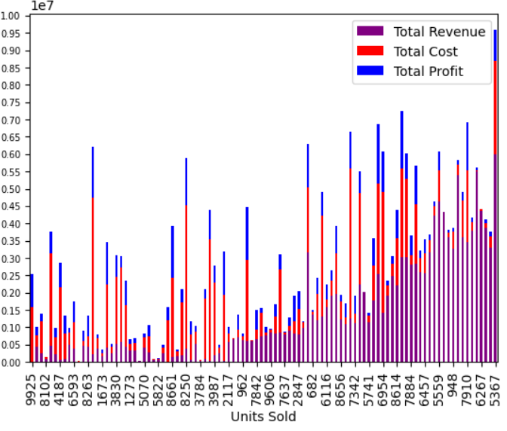
Total Sales for all the years
﻿2012 had the highest Revenue at 31.89M, followed by 2013 at 20.33M and 2010 at 19.18M﻿

Slide 5
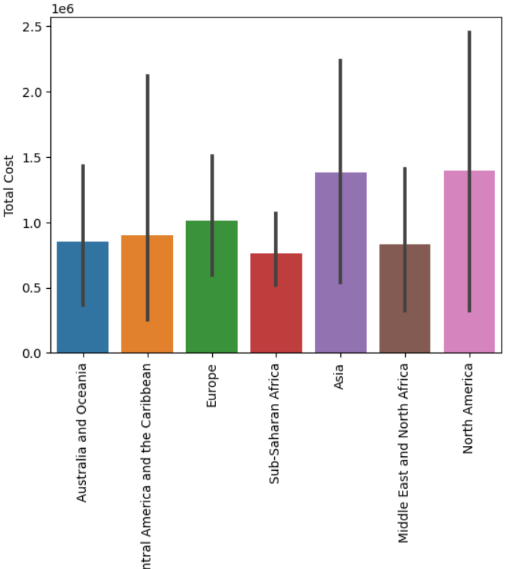
Revenue Categorized By Rgion
﻿
As we have seen more revenue is generated from the region Sub-Saharan Africa followed by Europe.
As we have seen more revenue is generated from the Country Djibouti at 6M.

Slide 6
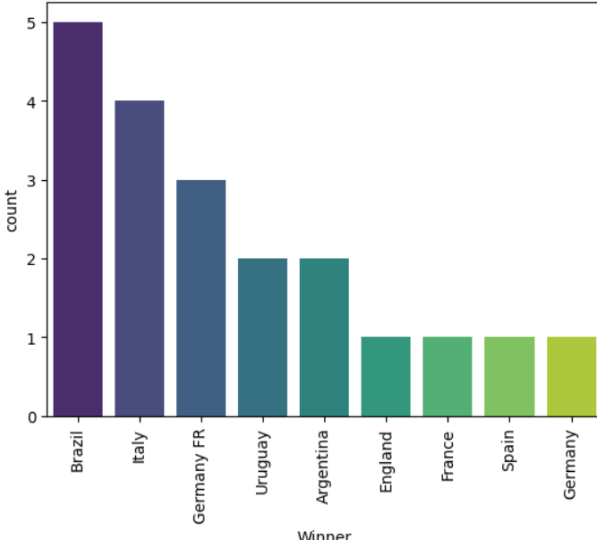
Winner of FIFA
Most of the winning by Brazil

Slide 7
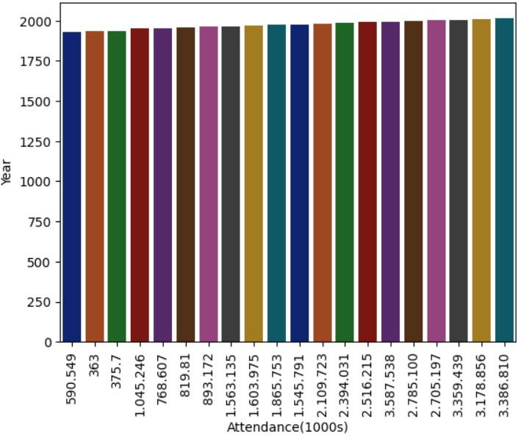
Participants in FIFA
Total number of attendance in years

Slide 8

Heart disease correlation
"Research shows a strong positive correlation between risk factors like high cholesterol, pretension, smoking, and the incidence of heart disease. Effective management of these factors can significantly reduce the likelihood of developing heart disease."

Slide 9
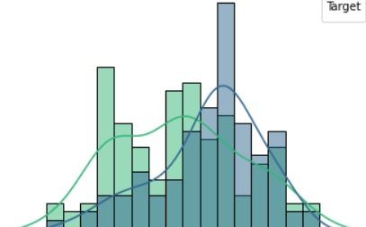
Heart Disease by Age
"Heart disease risk increases significantly with age, particularly after 45 in men and 55 in women. While it can affect younger individuals, older adults are at much higher risk due to accumulated risk factors such as high blood pressure, cholesterol, and long-term lifestyle habits."

Slide 10
Conclusion
1. Amazon's sales analysis indicates robust growth fueled by strong customer demand and market expansion. However, addressing rising competition and regulatory challenges will be crucial for maintaining momentum."
2 . The FIFA World Cup analysis highlights dominant performances from traditional powerhouses, with emerging teams showing increased competitiveness. Tactical innovations and individual brilliance continue to shape the outcomes of key matches."
3.
The analysis of heart disease indicates that lifestyle factors such as diet, exercise, and smoking are key determinants of risk. Early detection and management of these factors are essential to reducing the prevalence and impact of heart disease.

Slide 11
Thank you

